Slide 1
Points collection
Shape semantic decompsition

Slide 2
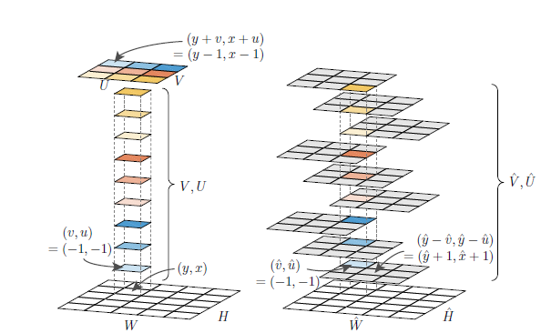
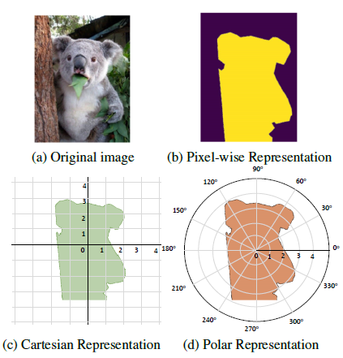
Single shot/stage instance segmentation
TensorMask
PolarMask
CenterMask

Slide 3
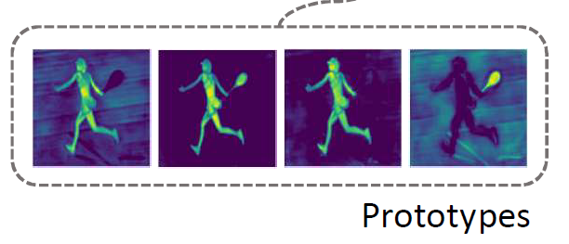
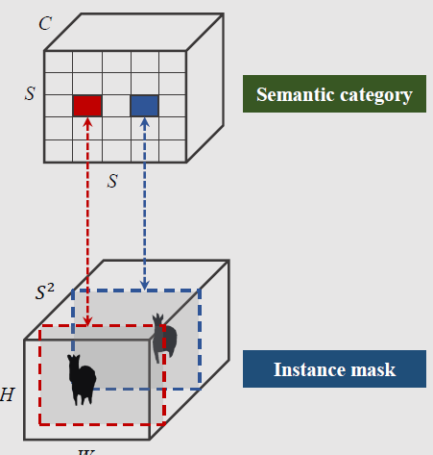
YOLACT
SOLO

Slide 4
?
(1)
(2)

Slide 5
Inplement
根据 detectron2
tensorMask
正在训练
但是会偶尔 loss NAN 崩掉 还在debug

Slide 6
Implement detail
Backbone:
Resnet 50 + 3 DCNop
With points collection op → 729 points
meta

Slide 7
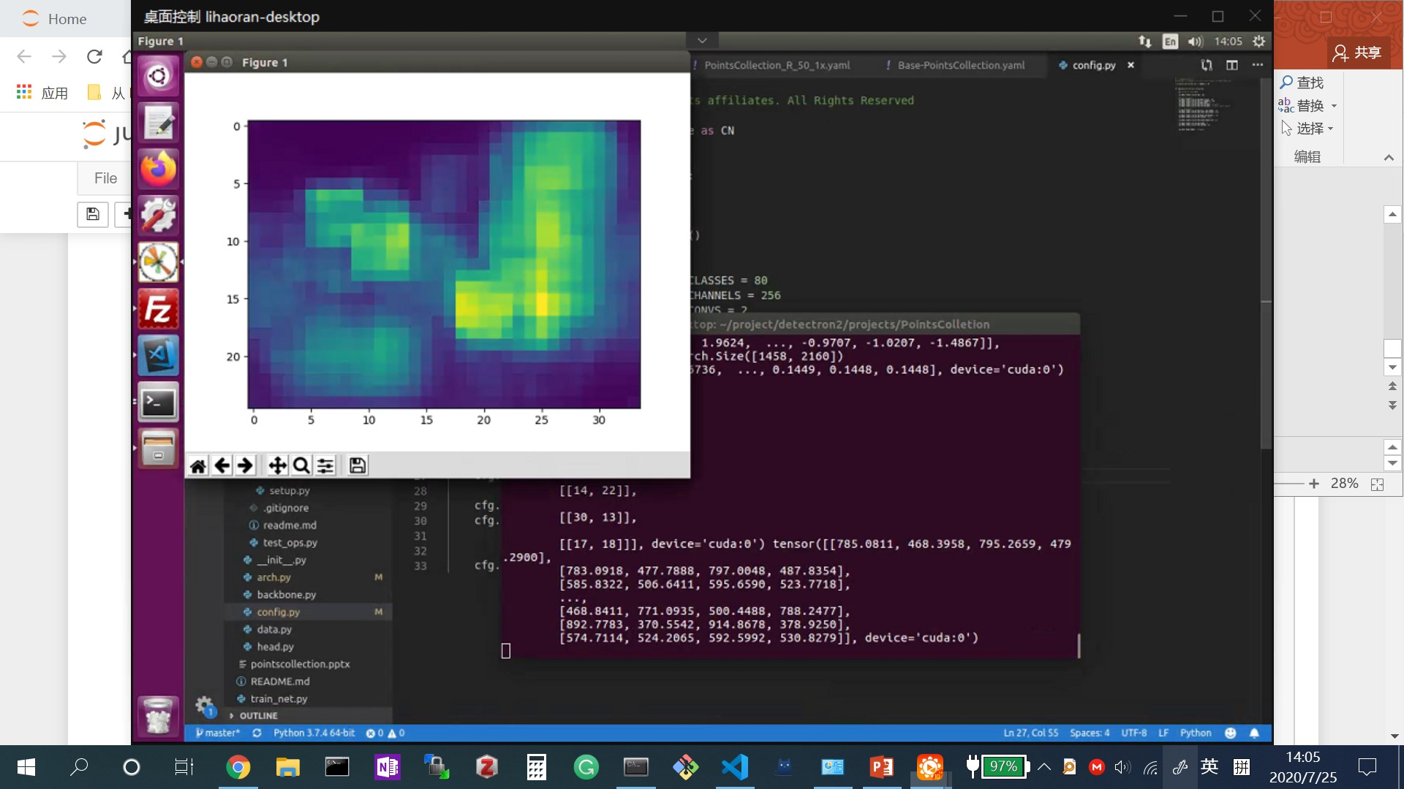

Slide 8
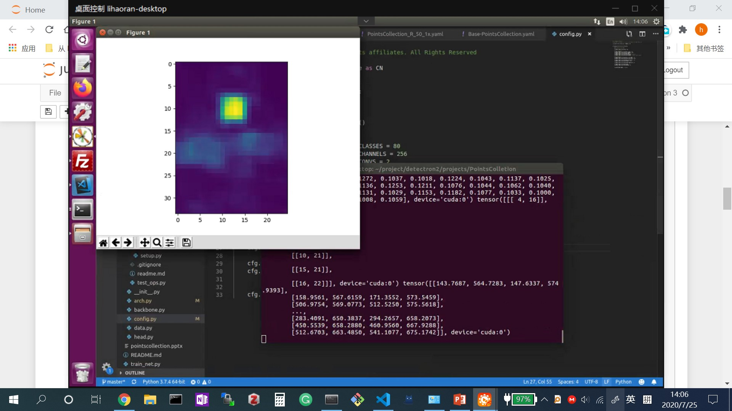

Slide 9
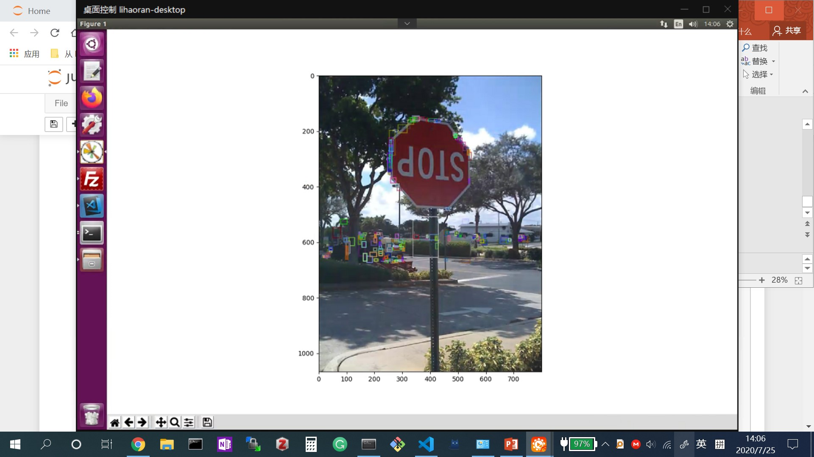

Slide 10
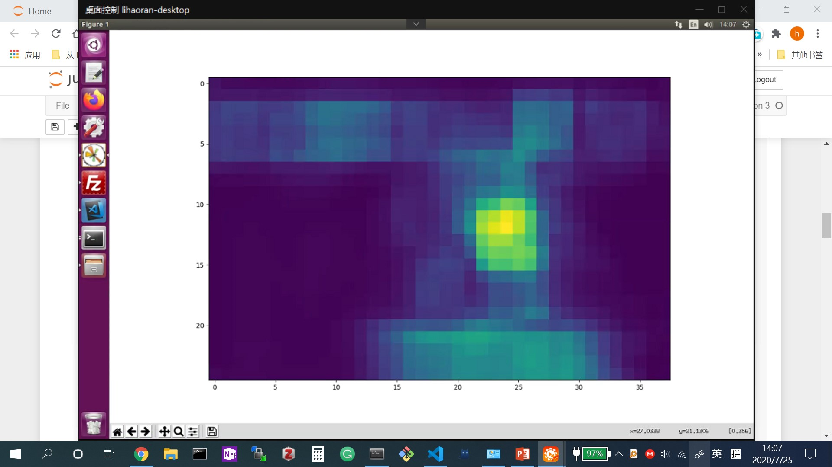

Slide 11
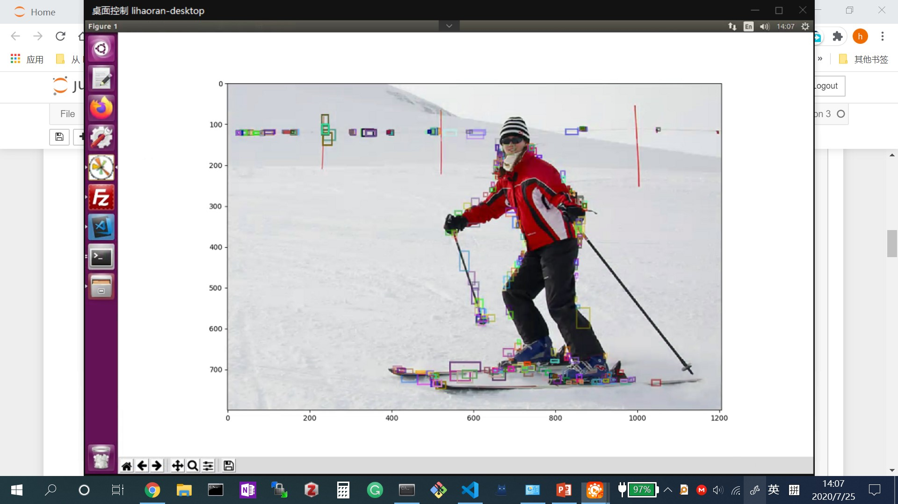

Slide 12
points
Grid sample
features
Bilateral filter

